Slide 1
Extending Dynamics 365 (Developer Training)

Slide 2
About me
Satish Reddy
Ex-Microsoft Employee
More than 10 years of experience in Microsoft Dynamics.
Worked on Dynamics CRM 3.0, CRM 4.0, CRM 2011, CRM 2013, CRM 2015, CRM 2016, Dynamics 365.
Working as Microsoft Certified Trainer and Architect.
Trained more than 35 companies on Dynamics across 4 continents.

Slide 3
Target Audience
Basics of Customization and Configuration of Dynamics 365.
Basics of C# or Java or C++ or any other object oriented language.
Basics of JavaScript, HTML and CSS.

Slide 4
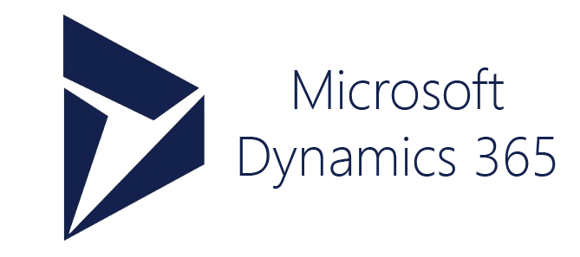
Target Audience
CRM (Customer Engagement)
ERP(Operations, Finance, HR, Retail)

Slide 5

Target Audience
Technical Consultant
Functional Consultant

Slide 6
Why Custom Code
Dynamics 365 is designed to be a generic product.
Not targeted for any specific industry.
It is job of technical consultants to customize the product according to specification of requirements.
Some customizations are simply configurations.
Like adding a new field, creating a new Entity.
These simple configurations can be done from UI.
Some Customizations need coding. There is no way you can do it from UI.

Slide 7
Why Custom Code 2
Scenarios for Coding.
Eg 1: Sending data to different system. i.e. during integrations.
Eg 2: Receiving data from other systems like currency exchange data.
Eg 2: Creating a complex reports.
Eg 3: Complex calculation or business logic.
Eg 4: Repetitive Tasks. Automation of remainder emails.
Eg 5: Google Maps in Dynamics 365.
Eg 6: Data Import & Export.
Eg 7: Deployment Automation.

Slide 8
Project Driven
Learn by Example Methodology
Sample Project: Contoso Insurance Management System.
Theoretical Concepts into Real World Use Cases.

Slide 9
Project Driven
Contoso is a leading insurance company. They are looking for software to manage contacts and their policies.
They want policy records

Slide 10
Prerequisite 1
Visual Studio 2017 Community Edition
https://visualstudio.microsoft.com/vs/community/

Slide 11
Prerequisite 2
Dynamics 365 Trial Instance
https://trials.dynamics.com/

Slide 12
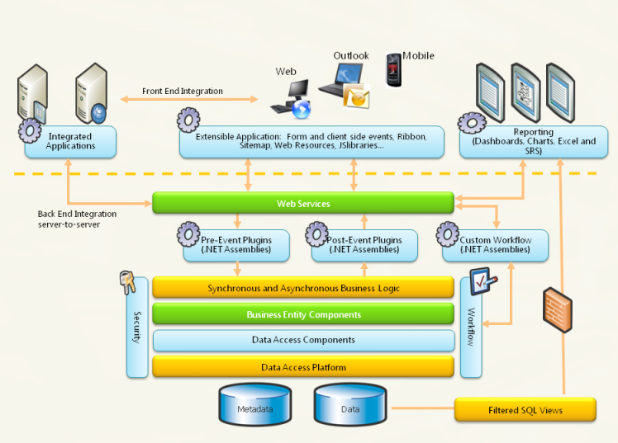
CRM Architecture

Slide 13
What custom code you can write
Server-side
Plug-ins
Custom Workflows
JavaScript Web resources
HTML Web resources
Client-side
Notes:
Scenarios for Custom code:
Automate business processes like sending email, creating task, calculations,
Integration scenarios like sending data to other web services, getting data from other applications
On client side, with JS and HTML, you create custom validations, custom UI.

Slide 14
Understanding Architecture
(
Custom Code(Plugins, Workflows, JS)
Web Services
CRM Databases

Slide 15
Web Services
Discovery Service
You can retrieve list of instances or organizations for given credentials.
Organization Service
You can connect to each instance or organization and perform all basic CRUD and advanced message operations.
Even to edit metadata (like creating entity, attributes etc.)
Each of the above service is available in two formats
SOAP : For server side coding.
REST (Web API): For client side coding.

Slide 16
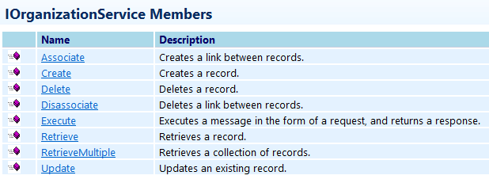

Web Services
Discovery Service

Slide 17
Finding End Points
Go to Settings → Customizations → Developer Resources

Slide 18
Plug-in
What is a Plug-in
A class library or assembly with custom code that runs on server events.
You can run Plugin code on common events like Create, Update, Delete, Assign etc. of specific record type.
Eg: On entering revenue field of contact record, you want to perform complex tax related calculations automatically.
Notes:
1. Most important component, most part of developer effort goes to Plugin development, 50% of custom code

Slide 19
Plug-in Pipeline : What happens on server
Main Event.
Client

Slide 20
Plug-in Pipeline : What happens on server
Main Event.
No Plugins Allowed Here.
Stage Number: 30
Stage: Pre-Validation
Stage Number: 10
Stage: Pre-Operation
Stage Number: 20
Stage: Post-Operation
Stage Number: 40
Security check
Server
Client

Slide 21
Plug-in Stages
Pre-Validation
Stage in the pipeline for plug-ins that are to execute before the main system operation.
Plug-ins registered in this stage may execute outside the database transaction.
Security Note: The pre-validation stage occurs prior to security checks being performed to verify the calling or logged on user has the correct permissions to perform the intended operation.
Scenarios: For server-side validations, we use this stage.

Slide 22
Plug-in Stages
Pre-Operation
Stage in the pipeline for plug-ins that are to execute before the main system operation.
Plug-ins registered in this stage are executed within the database transaction.

Slide 23
Plug-in Stages
Post-Operation
Stage in the pipeline for plug-ins which are to execute after the main operation.
Plug-ins registered in this stage are executed within the database transaction.

Slide 24
Plug-in Messages
Messages are nothing but events on which you trigger Plug-in.
Comprehensive list of Messages
https://docs.microsoft.com/en-us/dynamics365/customer-engagement/developer/supported-messages-entities-plugin

Slide 25
Plugin Development
How to develop a Plugin
Go to Visual Studio, Create a Class Library project for C#.
Download assemblies required using NuGet Package Manager.
Add a reference to Microsoft.Xrm.SDK.dll. This assembly is available in SDK.
You can implement IPlugin Interface from referenced assembly.
Notes:
Microsoft.CrmSdk.XrmTooling.PluginRegistrationTool

Slide 26
Plugin Development
Writing a basic Plugin
https://docs.microsoft.com/en-us/dynamics365/customer-engagement/developer/write-plugin#writing-a-basic-plug-in
.

Slide 27
Data passed to Plugin by Platform
IPluginExecutionContext contains information that describes the run-time environment that the plug-in executes, information related to the execution pipeline, and entity business information.
The InputParameters property contains the data that is in the request message currently being processed by the event execution pipeline.
if (context.InputParameters.Contains("Target") && context.InputParameters["Target"] is Entity)
{
// Obtain the target entity from the input parameters.
Entity entity = (Entity)context.InputParameters["Target"];
……….

Slide 28
Data passed to Plugin by Platform
// The InputParameters collection contains all the data passed in the message request.

Slide 29
Reading Data from Primary Entity in Plugin
Golden Rules
1. Platform only passes Entity attributes to Plugin that has change of data.
2. If the user does not enter any value into attribute, the attribute is not available in AttributeCollection of Entity.
3. Always check if attribute is present in the collection before you use it.

Slide 30
Registering Plugin On More than One Message
// The InputParameters collection contains all the data passed in the message request.

Slide 31
Second Plugin: Creating a Task
Scenario:
When user creates a contact, a task has to be created automatically by the system. The task is supposed to be completed within 2 days.

Slide 32
Third Plugin: Duplicate Check
Scenario:
System should not allow contacts with the same email address.
Goals:
Registering Plugin in Pre-Validation
Registering Plugin in more than one message
Accessing Organization service data

Slide 33
Data Retrieval Techniques
Using Retrieve
Query Expression
Query By Attribute
FetchXML
LINQ

Slide 34
Handle exceptions in plug-ins
InvalidPluginExecution Exception

Slide 35
Troubleshooting Plugins
Tracing
Logging
You need to enable explicitly in System Settings
Debugging

Slide 36
Debugging Plugins
Relatively difficult. But extremely useful when your Plugin code not working.
Steps to enable debugging
Install profiler (Only once)
Start profiling on step
Trigger step
Download log file
Stop profiling
Set breakpoint in Visual Studio
Attach to process, Plugin Registration Tool
Click debug on plugin reg tool
Supply .dll file and Error log file
Start execution
Can now click through steps of your program until you find bug

Slide 37
Pre and post entity images
Snapshots of the primary entity's attributes from database before (pre) and after (post) the core platform operation.
Pre-Entity Image in two scenarios
If you want to access field data before modification.
If you want to access some data of form that is not modified.

Slide 38
Accessing Pre entity images

Slide 39
Update Plugin
Scenario:
On Account record, there is Annual Revenue Per Employee attribute whose logic depends on both attributes Annual revenue or and Number of employees.
Create a plugin that updates Annual Revenue Per Employee when Annual Revenue or Number of employees changed.

Slide 40
Impersonation in plug-ins
By default, Plugin code runs under the security context of logged in user who is initiating transaction.
You can run plugins under different security context.
Impersonation at the time of registering step
Entire Plugin run under different user context.
Impersonation within Plugin Code
A few lines of code can be run under a different user context.

Slide 41
Pass data between plug-ins
Works within Plugins of same pipeline
Using Shared variables

Slide 42
Plugin Deployment: Isolation Mode
Also called Plugin Trust
Two Modes
Full Trust
No restrictions for Plugin code
Partial Trust or Sandbox
Plugins run under secure layer that prevents access to server's file system, registry, events.
Sandbox is the recommended execution environment for plug-ins as it is more secure, supports run-time monitoring and statistics .

Slide 43
Understanding Context.Depth in Plugin
When code in a Plugin causes the same Plugin to fire.
Scenario
A Plugin that runs on update of revenue field to round off the value and updates the same field.
Plugin

Slide 44
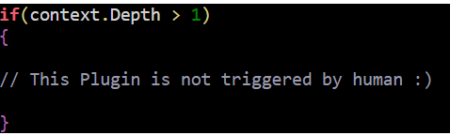
Understanding Context.Depth in Plugin

Slide 45
Handling Configuration data in a Plugin
Config data can be supplied at the time of registering a step
Accessed using a Constructor method
Secure Config Vs UnSecure Config

Slide 46
Asynchronous Plugin
By default, all Plugins are synchronous. i.e. All Plugins in the pipeline will be executed in a round trip of data from client to server.
But you can register a Plugin as Asynch mode which is not part of round trip.
So after Post stage, Async Plugin is triggered by Platform. Control does not wait till Async Plugin execution.
Technically Async Plugins are executed by Asynchronous Process (a windows service inside Dynamics Server or Cloud), the same process which is responsible for execution of background workflows.

Slide 47
Asynchronous Execution
System Main Event.
No Plugins Allowed Here.
Stage Number: 30
Async Plugins
Stage: Pre-Validation
Stage Number: 10
Stage: Pre-Operation
Stage Number: 20
Stage: Post-Operation
Stage Number: 40
Security check
Not part of round trip of data.
Triggered by main process.
Handled by different worker process.
Server
Client

Slide 48
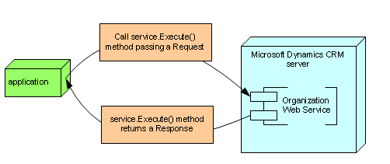
How to use execute method?

Slide 49
Common Request Response Classes
CreateRequest
UpdateRequest
DeleteRequest
AssignRequest
GrantAccessRequest
ExecuteWorkflowRequest
Calculate RollupFieldRequest
Notes:
There are hundreds of request - response classes.

Slide 50
Custom Workflow Activities
Dynamics 365 Offers basic workflow logic.
If you want advanced functionality, you can extend basic workflows with custom code.
Custom Workflow Activities are Asynchronous by default.
They are executed after System Main event.
You can expect some delay in execution as they are designed not to interfere with round trip of data.

Slide 51
Demo: Custom Workflow Activities
Scenario:
On Create of contact, we need to inform contact applicable Sales Tax by sending an email.

Slide 52
Custom Workflows: Development
Use Workflow Activity Library Project in Visual Studio.
Prepare a template

Slide 53
Custom Workflows: Asynchronous Execution
System Main Event.
No Plugins Allowed Here.
Stage Number: 30
Custom Workflow
Stage: Pre-Validation
Stage Number: 10
Stage: Pre-Operation
Stage Number: 20
Stage: Post-Operation
Stage Number: 40
Security check
Not part of round trip of data.
Triggered by main process.
Handled by different worker process.
Server
Client

Slide 54
Custom Workflow Activities
Input Parameters
Built-in Workflow
Custom Code (Custom Workflow)
Output Parameters

Slide 55
Plugin Vs Custom Workflow
If custom business logic needs to run manually, custom workflows can be chosen. Plugins always run based on server side events.
Synchronous or Asynchronous requirements of custom business logic largely determines whether to choose plugin or workflow.
If custom business logic needs to run synchronously, we can go for Plugin, otherwise, workflow.
Plugin allows custom business logic to run under current user security context, whereas in case of workflows, code runs under Workflow’s owner.
Flexibility of impersonation is easily available with Plugins.
“Wait functionality” is possible with custom workflows
Workflows logs can be tracked as system jobs. They can be scheduled to run again if they have failed.
Plugins support more messages apart from default CRUD messages. Workflow messages are limited.

Slide 56
CRM to Console App Integration
Why Console App
Simple command line tool that interacts with Dynamics 365.
External tool outside of Dynamics 365 Scope.
A way of demonstrating integrations of data from Dynamics 365 from different applications.
Fastest way of learning Web Services as it is easy to debug with a simple breakpoint.
Console Apps can be Utility tools that perform repetitive tasks such as Data Import, Data Cleansing, Deployment Automation etc.

Slide 57
CRM to Console App Integration
New Simplified Authentication
Calling a Web Service
Lab

